Slide 1
Middleware for Cooperative Interaction of Things
Draft for paper
Soobin Jeon
Advisor : Inbum Jung

Slide 2
Contents
Introduction
Research Topics
Middleware for Internet of Things
System Layer
Interaction Layer
Sensor Abstract Layer
Evaluation and result
Conclusion

Slide 3
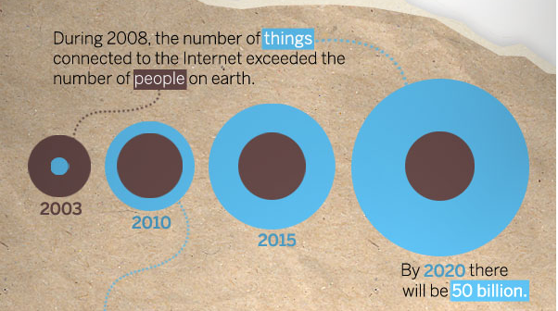
Introduction
Internet of Things (IoT)
All things: Devices, vehicles, buildings and other items
Connected to internet
Collect and exchange data

Slide 4
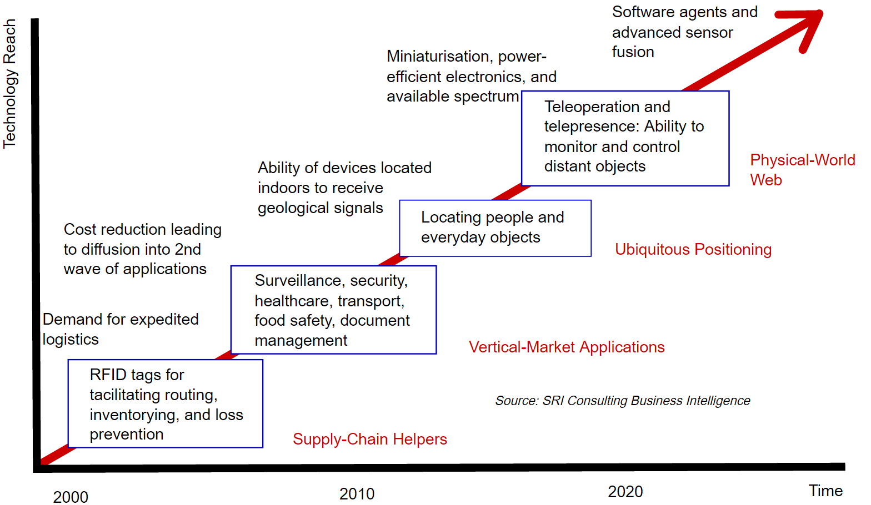
Introduction
Technology Roadmap: The Internet of Things

Slide 5
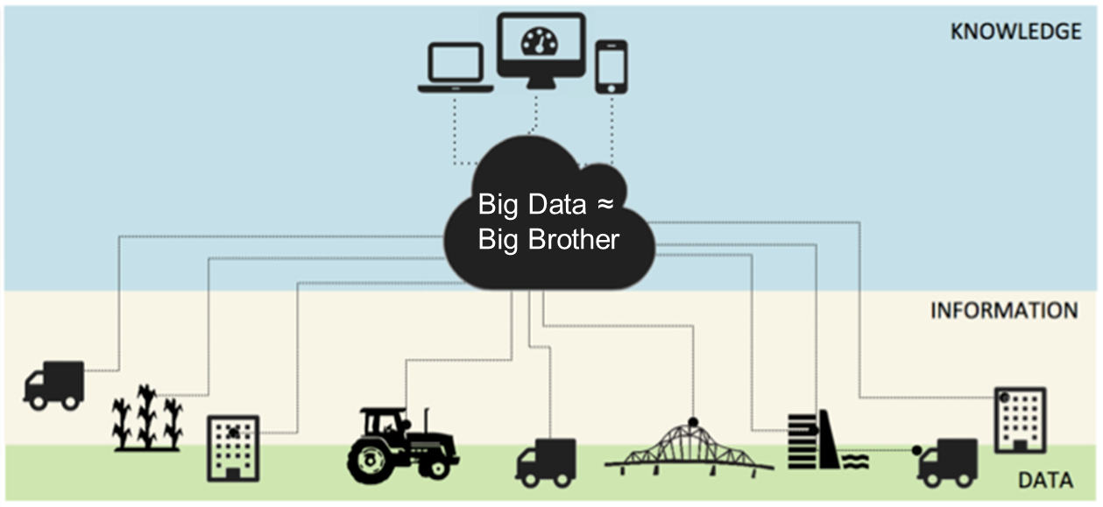
Introduction
Centralized Infrastructure based on IoT
Centralized storage
Invasion of privacy
Information Utilization
Notes:
IoT 서비스 자체가 매우 지역적임에도 불구하고 모든 데이터를 중앙에 집중 저장 관리 분석함
엄청난 에너지 낭비
중앙서버 마비시 모두 마비
비용
설치가 어려움
지극히 개인적인 데이터(생체 신호, 가전제품 활용 정보, 개인 피트니스 정보,…)를 글로벌 통신 사업자가 독점
→ 2nd NAVER
엄청난 데이터 양(Everyday around 20 quintillion (10^18) bytes of data are produced에 비해 활용가치가 높지 않음
통신사업자(Big Brothers)가 사업권을 독점하여 새로운 비즈니스 틈새가 없음

Slide 6
Introduction
Private or Localized Middleware Platform for IoT
Anywhere
Independent action
Information Distribution
Low cost / energy
Easy set up
Privacy
Notes:
지역 기반의 IoT 구조가 필요함

Slide 7
Existing Research
Middleware is fundamental for IoT operation
Most of things are made by Middleware platform
Existing Middleware Platform
Inventing
Inconvenience
Constrained network support
Centralization

Slide 8
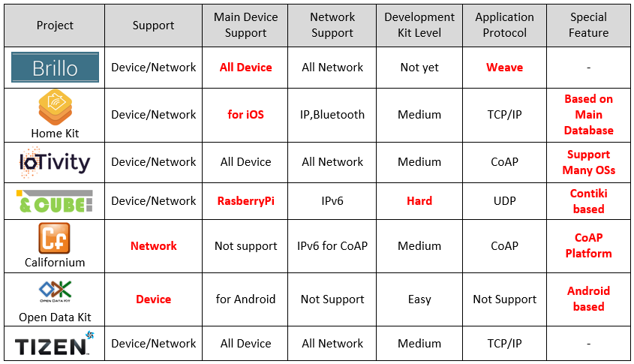
Existing Research
Existing Project

Slide 9
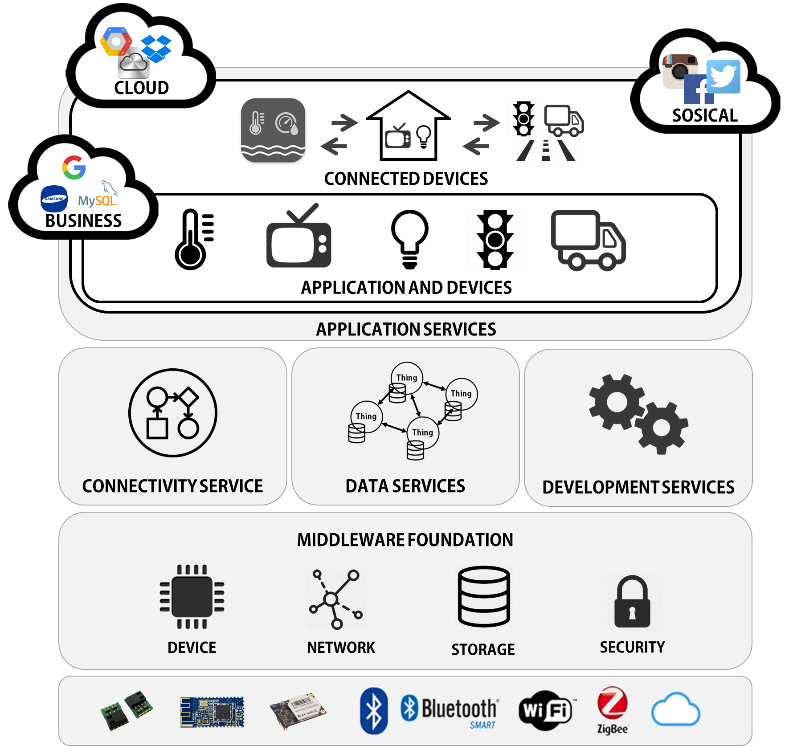
Overview
Private or Localized Middleware Platform for IoT

Slide 10





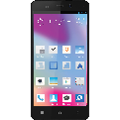


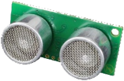
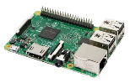
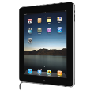



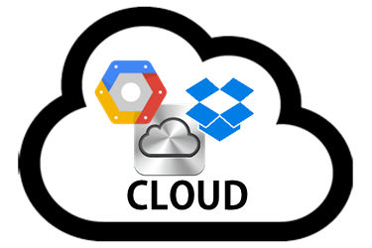

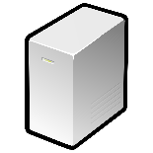


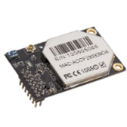


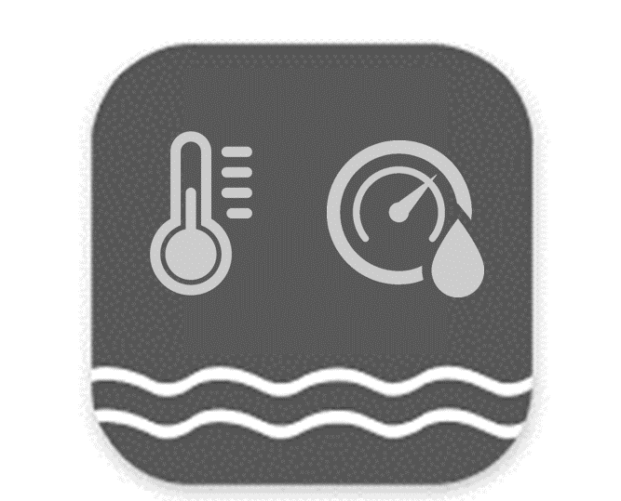

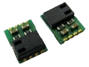
Concept
Heterogeneous networks
(WiFi, Bluetooth, BLE, Zigbee)
Simple Connection with sensor devices
(GPIO, ADC, SPI, UART)
Localization
Traffic
BLE, WiFi, Zigbee
MinT Middleware
CoAP
Home
INTERNET
World-wide servers
Variable platforms
(Windows, Android, Linux)
Seamless connectivity
(easily, quickly, lightly)
Environment
Sensor

Slide 11
Concept
Localization
Traffic
BLE, WiFi, Zigbee
MinT Middleware
CoAP
Home
INTERNET
World-wide servers
Environment
Sensor

Slide 12
Proposal
Middleware for making and operating an IoT device
Challenges
Heterogeneous devices & networks
Quick connection & Interaction
Easy development & installation
Storage Management
Low power consumption
High performance

Slide 13
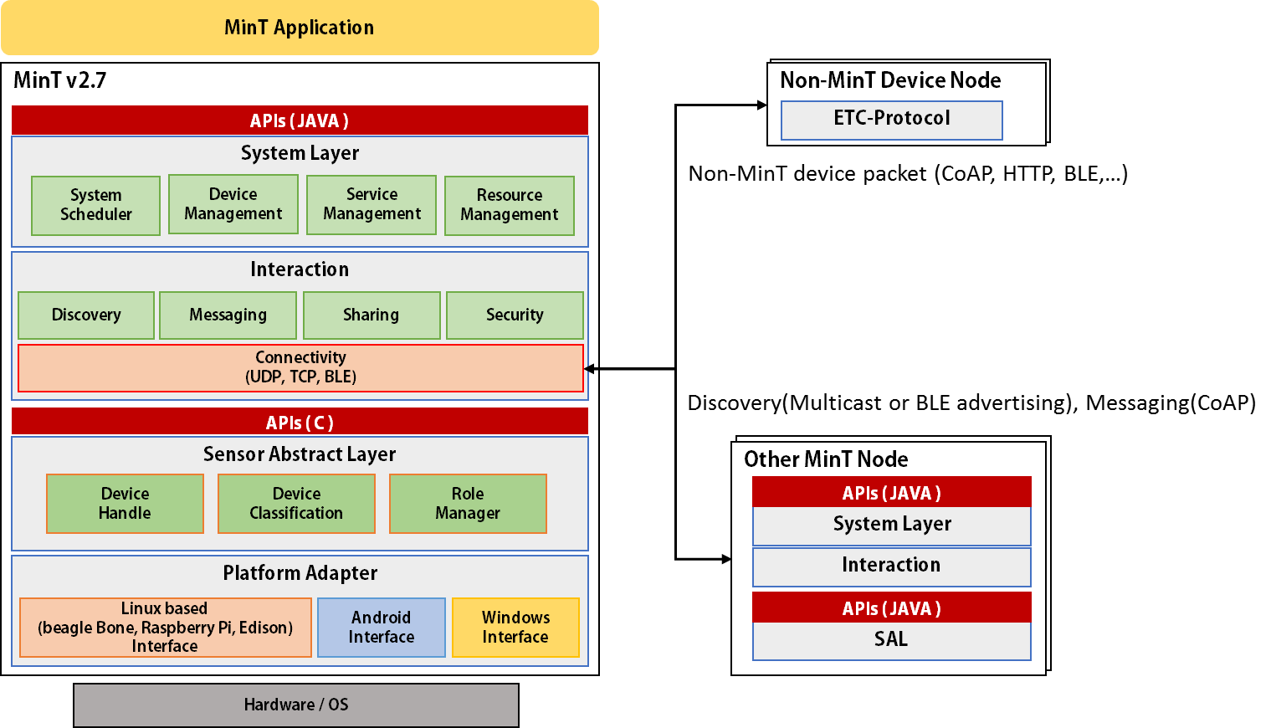
Architecture (그림 수정)

Slide 14
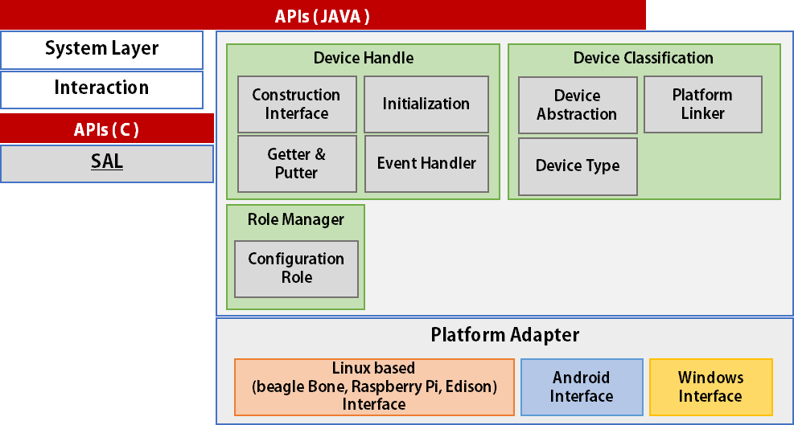
Sensor Abstract Layer

Slide 15
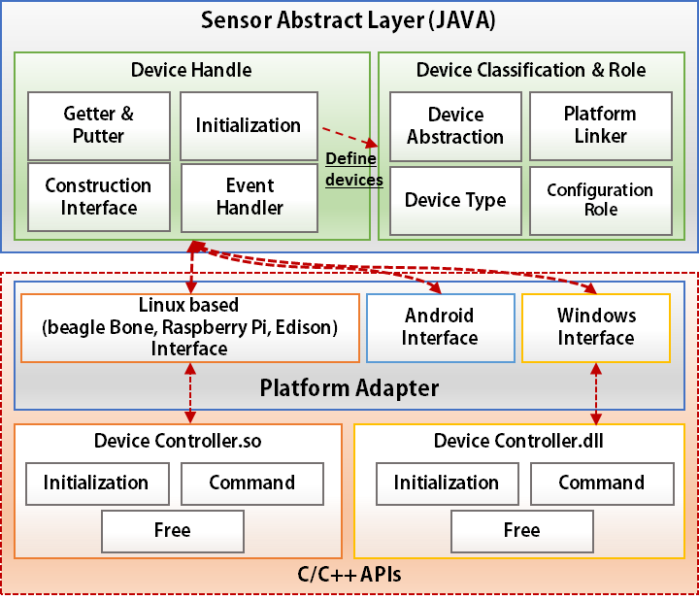
Sensor Abstract Layer

Slide 16
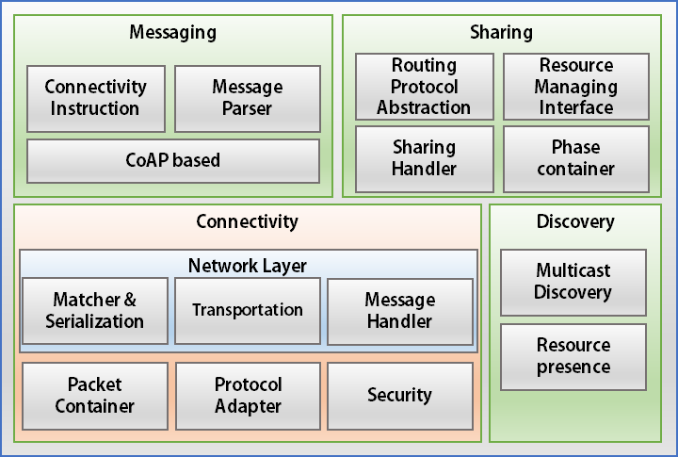
Interaction Layer

Slide 17
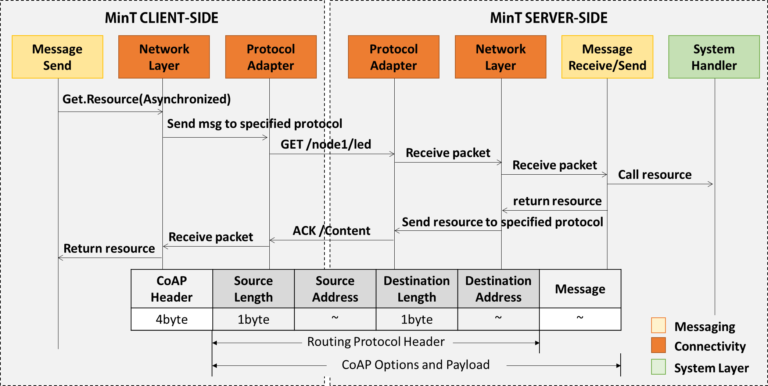
Interaction Layer

Slide 18
Connectivity
Network Connectivity
Resource Send/Receive
Received Message Handle
GET, POST, PUT, DELETE
Sensor operation
Message response of request
Heterogeneous protocol handle
UDP, TCP, BLE, BT..

Slide 19
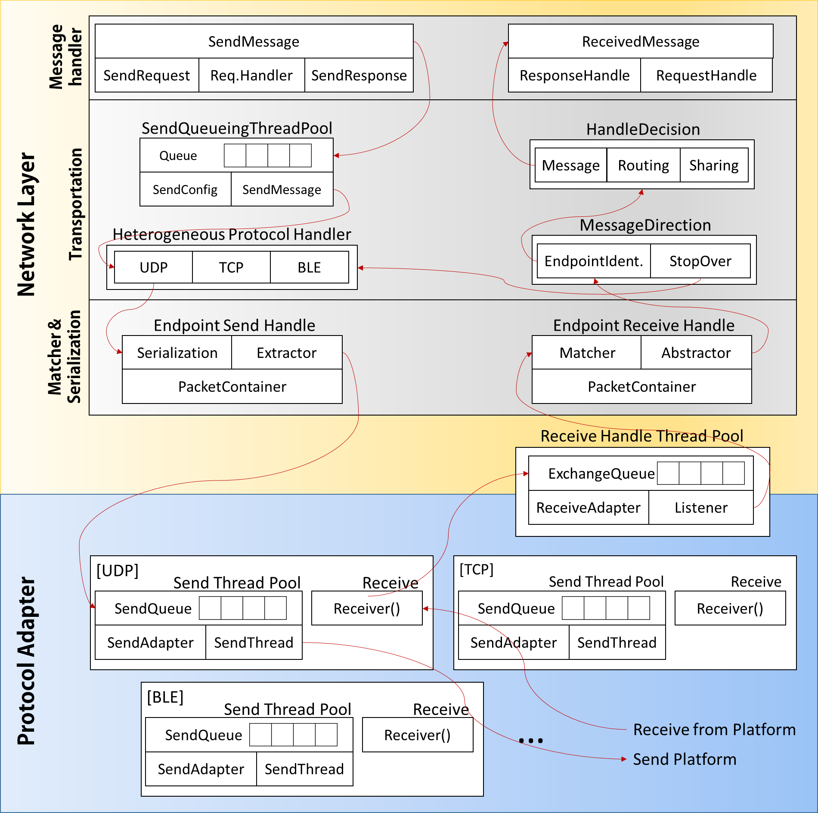
Connectivity Architecture - flow

Slide 20
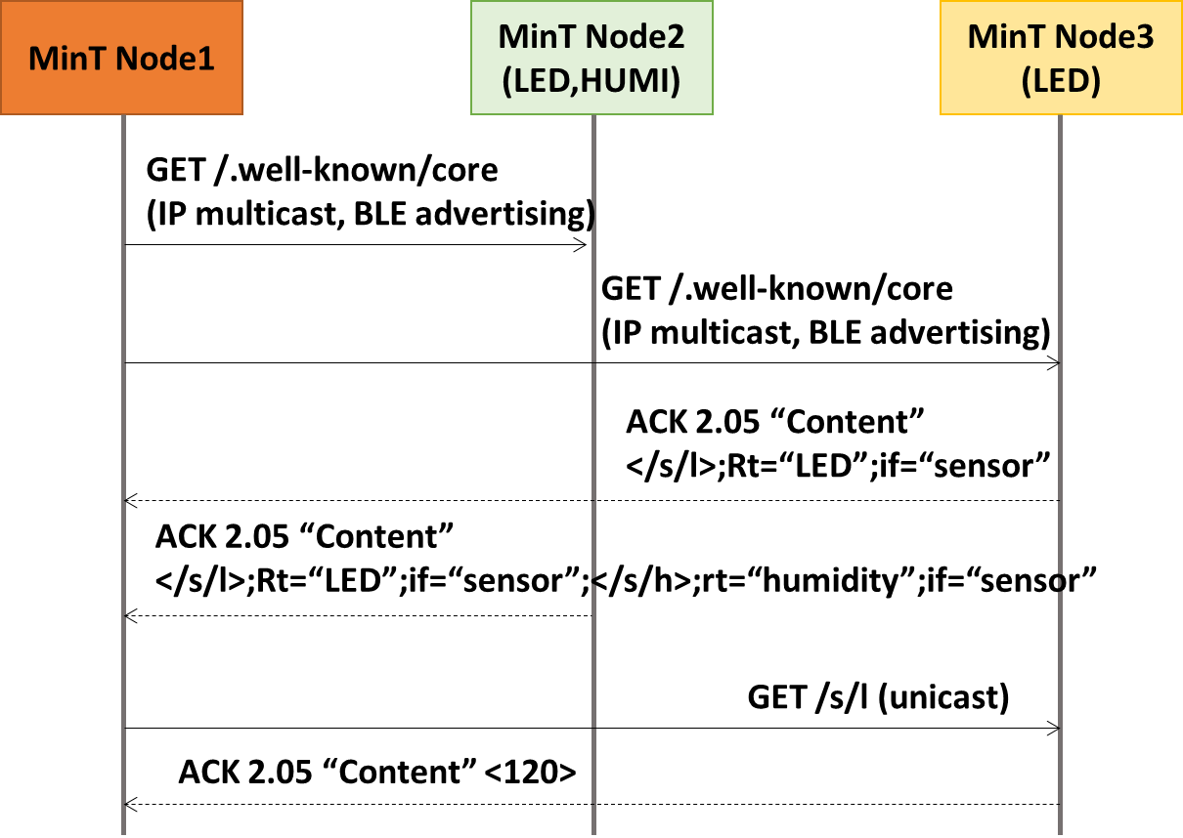
Connectivity Architecture - Discovery

Slide 21
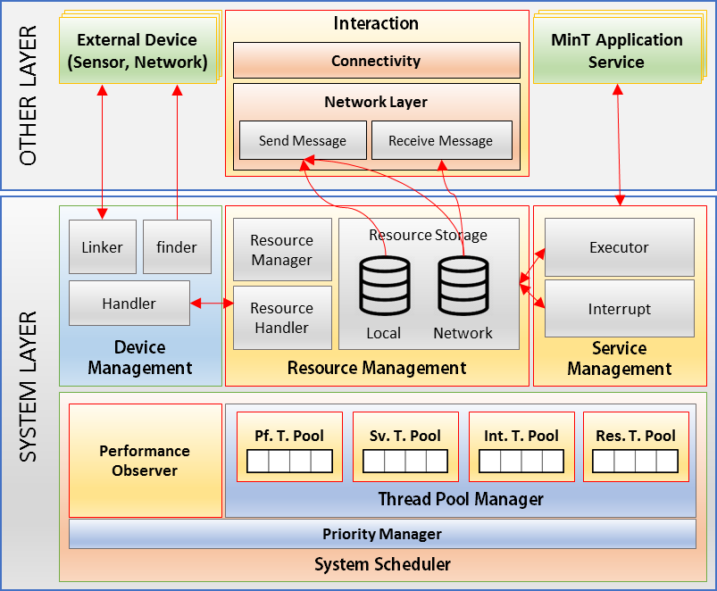
System Layer

Slide 22
System Scheduler
Efficient operating and scheduling of MinT framework
Thread Pool Manager
System thread pool group management
Priority Manager
Priority decision of system thread pool group
Performance Observation
Performance evaluation of system
Thread Adjustment
System thread pool size adjustment

Slide 23
System Scheduler
Scheduled Thread Pool Group
Application Service
Managing Services that operate the device
Resource Management
Managing resource operators collected by installed sensors
Information Exchange
Routing & network protocol, message handle
Performance Profile
Profiling thread performance
MinT System Scheduler
(Priority)
Java Priority
MIN = 1
MAX = 10
Application Service
(5)
Resource Management
(5)
Information
Exchange
(6~10)
Performance
Profile
(4)
ETC
(5)

Slide 24
Performance Evaluation
Throughput(request/sec) of MinT, Californium and nCoAP
Throughput by packet block size (MinT, Californium)
Throughput by device platforms (MinT, Californium)

Slide 25
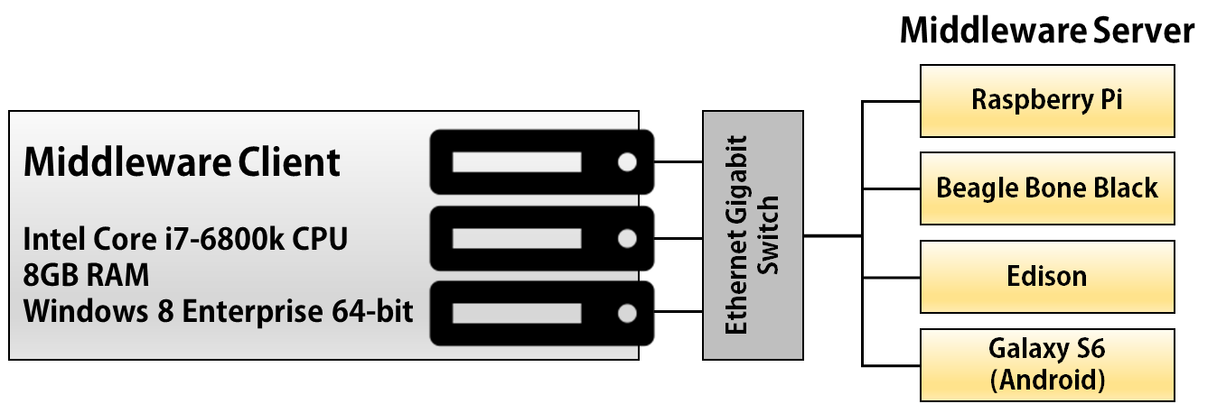
Performance Evaluation
Experiment Environment
Network
CoAP (UDP)
Concurrency factor(number of clients): from 1 to 10000
Period
10 requests / sec
Stress for a 60 sec

Slide 26
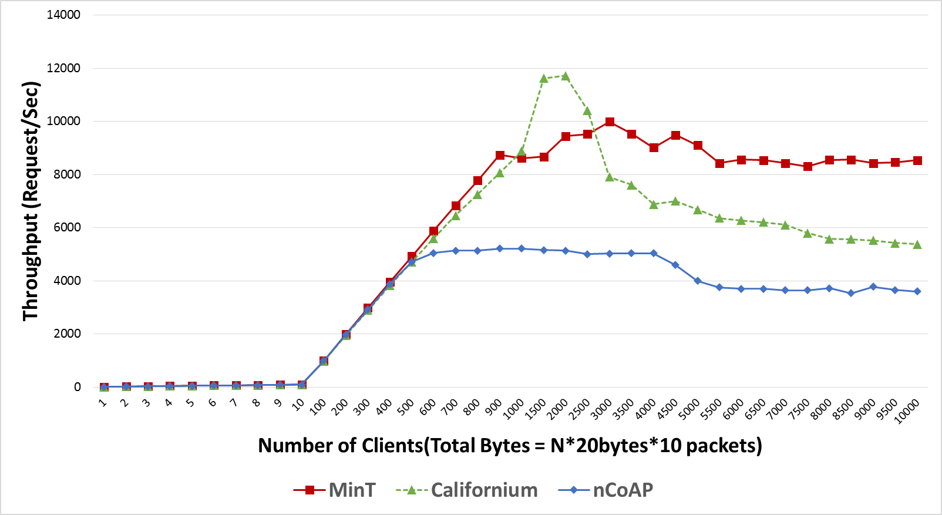
Performance Evaluation
Throughput (request/sec) of MinT, Californium and nCoAP

Slide 27
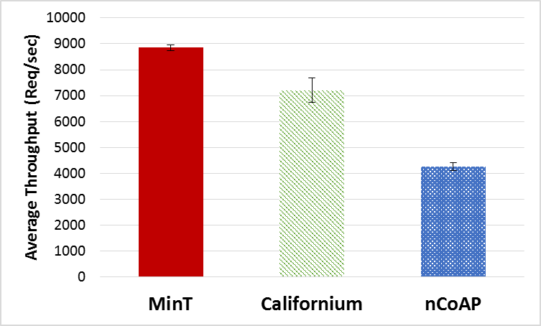
Performance Evaluation
Throughput (request/sec) of MinT, Californium and nCoAP

Slide 28
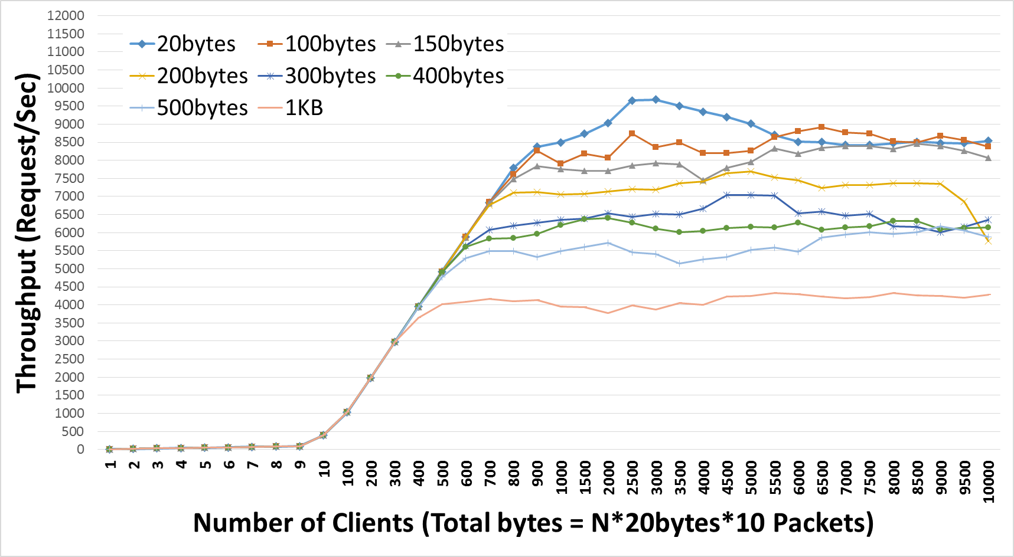
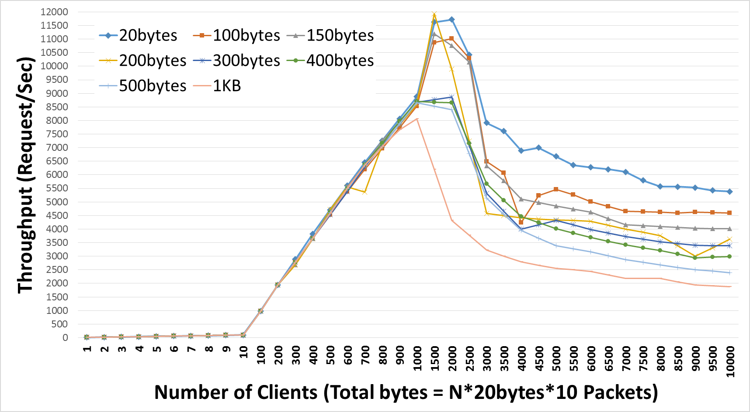
Performance Evaluation
Throughput by Packet Block Size
MinT
Californium

Slide 29
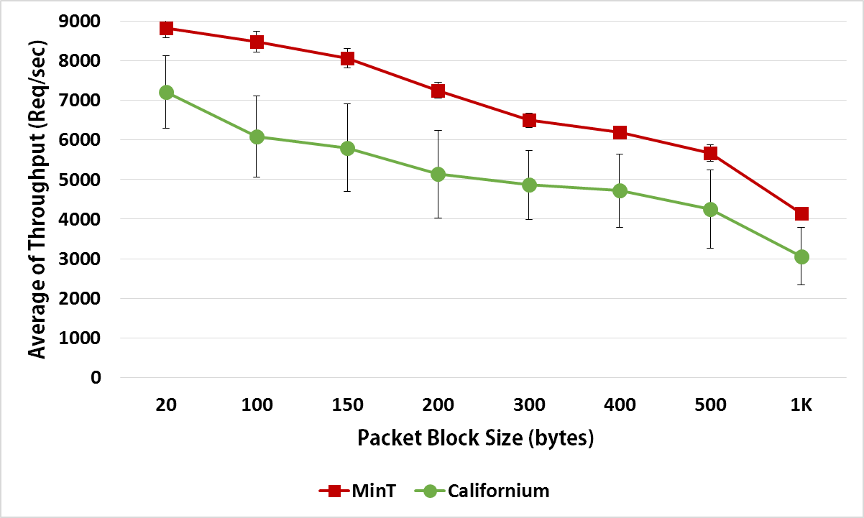
Performance Evaluation
Throughput by Packet Block Size

Slide 30
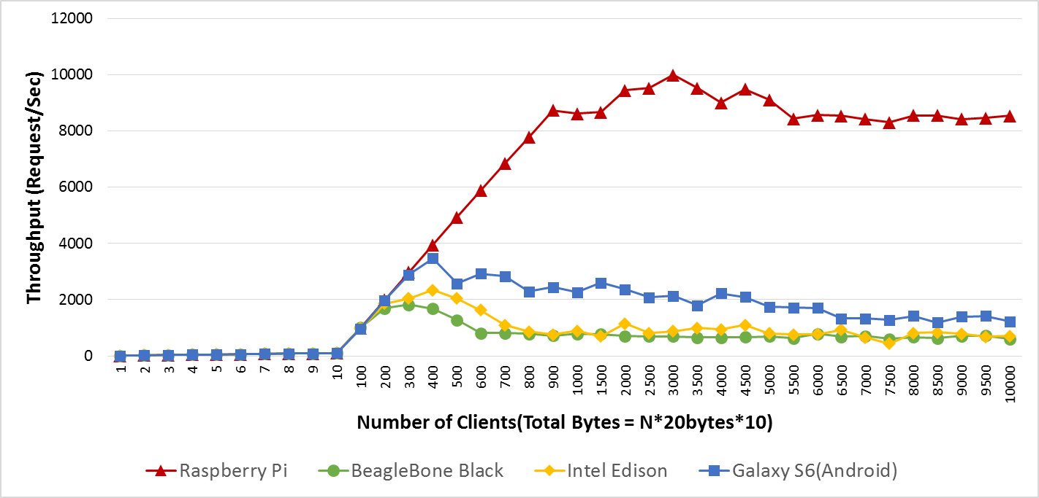
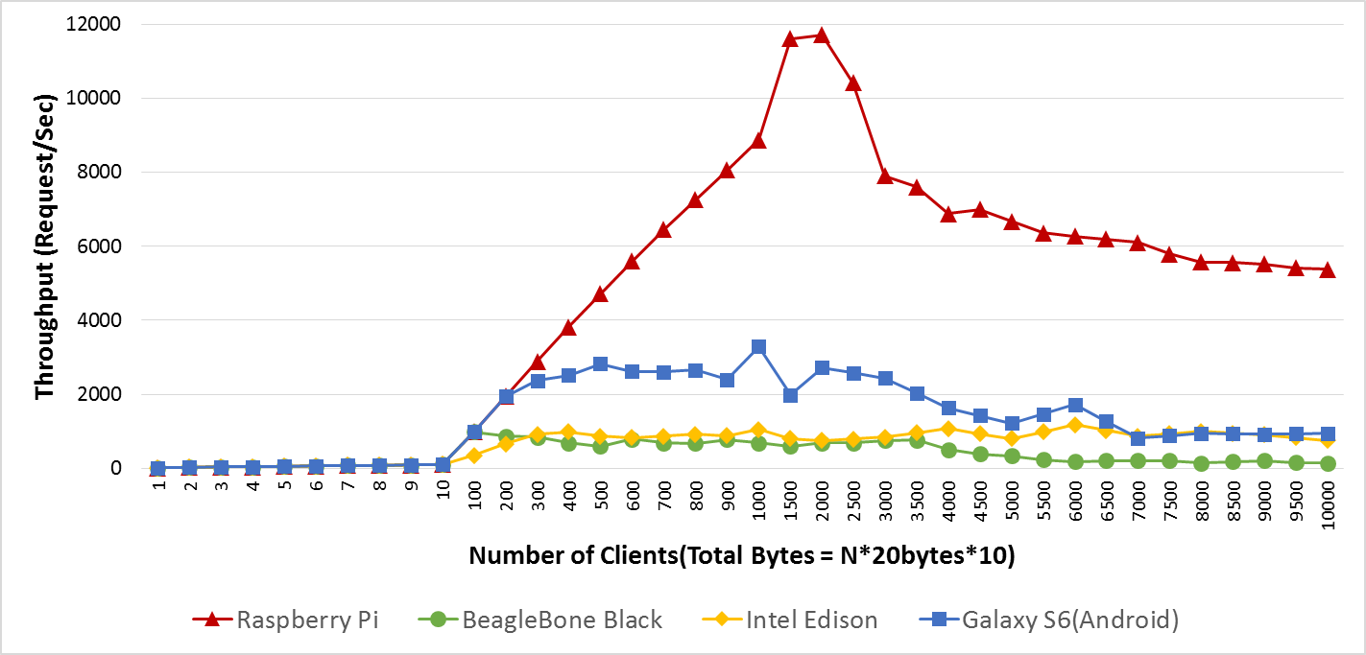
Performance Evaluation
Throughput by device platforms (MinT, Californium)
MinT
Californium

Slide 31
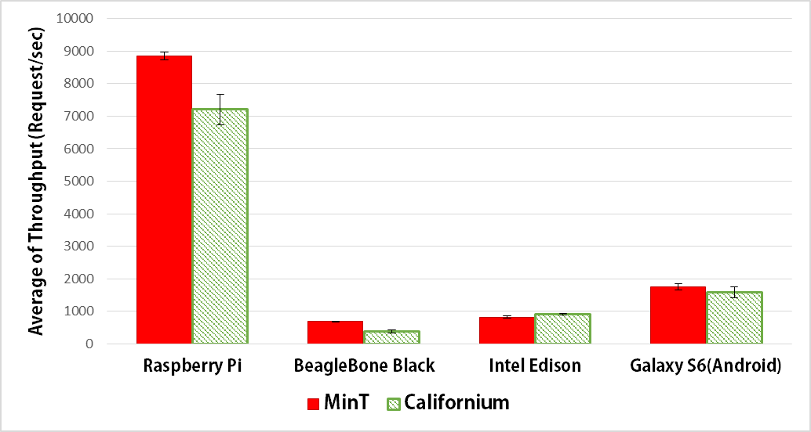
Performance Evaluation
Throughput by device platforms (MinT, Californium)

Slide 32
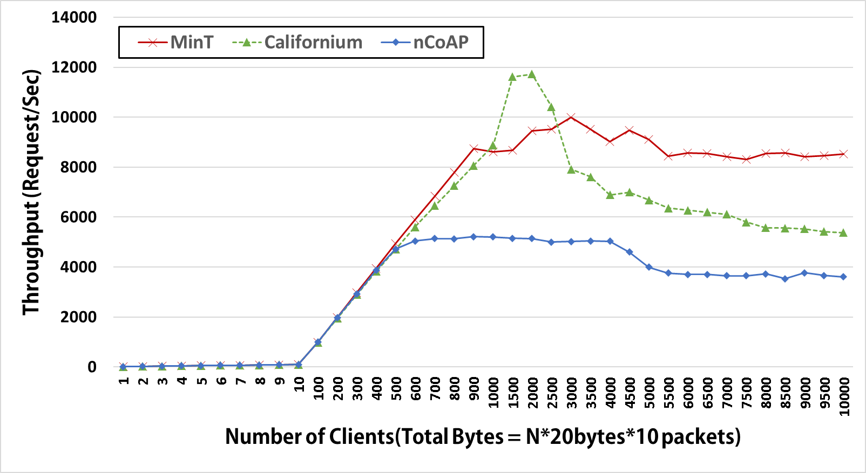
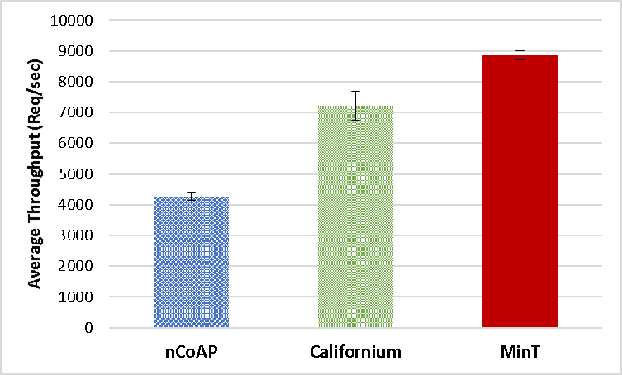
(a)
(b)

Slide 33
Conclusion
Middleware for making and operating an IoT device
Heterogeneous devices & networks
Quick connection & Interaction
Storage Management
Low power consumption & High performance
Future work,
A scalable distributed information sharing between nodes
System scheduling detail

Slide 34
Q&A

Slide 35
Reference
[1] Atzori, L., Iera, A. and Morabito, G., "The internet of things: A survey," Computer networks, Vol 54, No 15, pp.2787-2805, 2010.
[2] Da Xu, L., He, W. and Li, S., "Internet of things in industries: A survey," IEEE Transactions on Industrial Informatics,Vol 10, No 4, pp.2233-2243, 2014.
[3] Whitmore, A., Agarwal, A. and Da Xu, L., "The Internet of Things—A survey of topics and trends," Information Systems Frontiers,Vol 17, No 2, pp.261-274, 2015.
[4] C. S. Lee, S. B. Jeon, Y. T. Han, I. B. Jung, “Integrated Platform for Device Development in Internet of Things,” Proc. of the KIISE Korea Computer Congress 2015, pp.471-473, 2015. (in Korean)
[5] Lomotey, R., Deters, R., Nilson, J., Mulder, K., Wittmeier, K. and Schachter, C., "Mobile Medical Data Synchronization on Cloud-Powered Middleware Platform," IEEE Transactions on Services Computing, Vol 9, No 5, pp757-770, Apr. 2016.
[6] Park, T., Abuzainab, N. and Saad, W., "Learning how to communicate in the internet of things: Finite resources and heterogeneity," IEEE Access, Vol 4, pp.7063-7073, Nov 2016.
[7] IoTivity [Online]. Available: http://www.iotivity.org(accessed on 2016, Dec. 09)
[8] Alliance, Allseen, Introduction to the Alljoyn Framework, 2014.
[9] Brillo [Online]. Available: http://developers.google.com/brillo(accessed on 2016, Dec. 09)
[10] Levis, P., Madden, S., Polastre, J., Szewczyk, R., Whitehouse, K., Woo, A., Gay, D., Hill, J., Welsh, M., Brewer, E. and Culler, D., Tinyos: An operating system for sensor networks, pp. 115-148, Heidelberg, Berlin, 2005.
[11] Shelby, Z., Hartke, K. and Bormann, C.,(2014, June). The Constrained Application Protocol(CoAP) [Online]. Available: https://www.rfc-editor.org/info/rfc7252(downloaded 2016. Dec. 09)
[12] Kovatsch, M., Lanter, M. and Shelby, Z.,"Californium: Scalable cloud services for the internet of things with coap,"Internet of Things (IOT), 2014 International Conference on the. IEEE, pp. 1-6, 2014.
[13] nCoAP [Online]. Available: https://github.com/okleine/nCoAP(accessed on 2016. Dec. 09)
[14]Rahman, A. and Dijk, E.,(2014, Oct). Group communication for the Constrained Application Protocol (CoAP) [Online]. Available: https://www.rfc-editor.org/info/rfc7390 (downloaded 2016. Dec. 09)
[15] Shelby, Z.,(2012, Aug). Constrained RESTful Environments (CoRE) Link Format [Online]. Available: https://tools.ietf.org/html/rfc6690 (downloaded 2016. Dec. 09)
[16] C. S. Lee, Y. T. Han, S. B. Jeon, I. B. Jung, “Heterogeneous Network Integrated Framework for Internet of Things,” Proc. Of the 2015 KIISE Winter Conference, pp.443-445, 2015. (in Korean)
[17] Android Threading Performance[Online] Available

